Slide 1
Student
Research
Experience
Notes:
Intro - wendy

Slide 2

Why is research important?
How is the culture of nurses in research changing?
How are LYPFT developing research opportunities for students?
Contents
Notes:
Wendy

Slide 3

Why is Research Important in Mental Healthcare?
Research aims to improve the future in healthcare:
Prevention
        E.g. identifying risk factors, early management/intervention, reducing restrictive practices
Diagnosis
Does the label effectively describe someone's experience? Does symptomatology present differently in different groups? What overlap of factors constitute a diagnosis?
Treatment
Modalities of therapy, medicines and their management, behaviour change strategies
Best Practice
Ensures policy reflects evidence base, improve competency of staff/carers/patients, ethical conduct
Economy
Best use of a limited resource - increases efficiency, reduces treatment cost/time, receive funding from commercial research
Many benefits of involvement for clinical staff
Notes:
Wendy

Slide 4
Current Climate and Implications for Nursing Students
Theoretical syllabus but no formal clinical element of MH nursing education
This is offered to other mental health disciplines; medicine, psychology etc.
Theory-practice gap in mental health nursing
    Generic NMC standards for pre-registration education
    Lack of MH (nursing) presence in research
    Discussed at RCN congress June 2022
    For those choosing clinical academia, the path through this can be convoluted and confusing
Sources
Warrender, D. 2021. Mental health nursing and the theory-practice gap: Civil war and intellectual self-injury. Journal of Psychiatric and Mental Health Nursing.
29(2), pp. 171-173
Notes:
Han

Slide 5
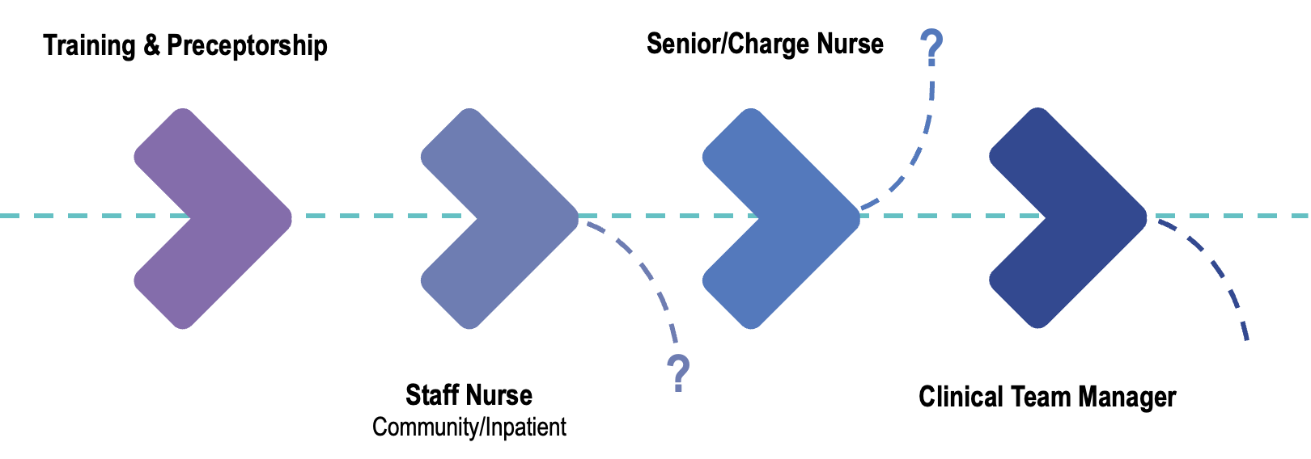

Perceived Nursing Career Progression
Notes:
Wendy/Han

Slide 6
An Alternative Route!
Research
Sources
Warrender, D. 2021. Mental health nursing and the theory-practice gap: Civil war and intellectual self-injury. Journal of Psychiatric and Mental Health Nursing.
29(2), pp. 171-173
Notes:
Wendy

Slide 7

Responsible for assessing and managing the care pathways of patients and carers participating in research studies; ensuring good communication between research and clinical teams
The role involves using an in-depth knowledge of clinical trial protocols and their application in practice to effectively set-up, deliver and recruit to research studies in the NHS. The role tends to be half clinical and half office based.
Research Nurse
(Clinical)
Notes:
Wendy

Slide 8
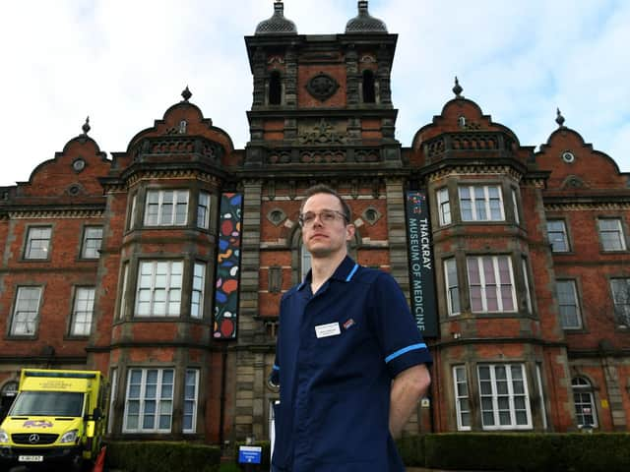
Identify potential projects, and coordinate research funding bids and related opportunities to develop & strengthen research profile
Lead research in the NHS, managing staff and networking effectively to ensure the effective implementation and delivery of research
Lead Research Nurse
(Clinical)
Notes:
Wendy

Slide 9

As a Lecturer you will have the opportunity to contribute to the teaching portfolio working primarily on the undergraduate BSc (Hons) health related programmes which focus on the theoretical and clinical elements which underpin the fundamentals of practice. You will also have the opportunity to teach on and assess students on postgraduate modules and programmes
Research is an element embedded into most lecturer positions, ensuring academic units are at the forefront of research
Lecturer
(Academic)
Notes:
Wendy

Slide 10

Change in the Culture of NHS Research and Nurse Involvement
Notes:
Wendy

Slide 11

Chief Nursing Officer for England
-Ruth May-
“Research led by nurses and contributions they make as members of multidisciplinary research teams can drive change. It is the cornerstone of high-quality, evidence-based nursing.”
Notes:
Wendy

Slide 12

Sustainable and supported careers
‘This includes raising awareness of the breadth of opportunities for nurses to become involved in research – whoever they are and wherever they work. We will design a framework to enable seamless transition through the stages of a research-related career. This also means increasing opportunities during pre-registration nursing programmes so students can experience the variety of research-related roles available to them throughout their careers.’
Ruth’s Strategy for Research
https://www.england.nhs.uk/wp-content/uploads/2021/11/B0880-cno-for-englands-strategic-plan-fo-research.pdf
Notes:
Wendy

Slide 13

Saving and Improving Lives: The Future of UK Clinical Research Delivery
-Policy Paper-
“This means embedding clinical research at the heart of patient care across the NHS, making participation as easy as possible and ensuring all health and care staff feel empowered to support research”
Notes:
Wendy

Slide 14

“We know that being involved in research improves patient outcomes and staff retention. However, not all patients and members of the public are offered opportunities to be involved in research studies. A key goal of the Department of Health and Social Care’s Equality, Diversity and Inclusion Strategy is to ensure people with the greatest health need are supported through research. Hence it is essential nurses know about studies taking place in their area of work and can support people who want to join studies.”
Director of Nursing NIHR
-Ruth Endacott-
Notes:
Wendy

Slide 15

CNO Strategic Plan for Research
NHS England
Aligning nurse-led research with public need – so the portfolios of relevant funders reflect the research priorities of patients, carers, service users, residents, the public and our profession
Notes:
Wendy

Slide 16
CNO Strategic Plan for Research
NHS England
Releasing nurses’ research potential – to create a climate in which nurses are empowered to lead, use, deliver and participate in research as part of their job, and the voice of the profession is valued
Notes:
Wendy

Slide 17

CNO Strategic Plan for Research
NHS England
Building the best research system – So that England is the best place for nurses to lead, deliver and get involved in cutting-edge research.
Notes:
Wendy

Slide 18

CNO Strategic Plan for Research
NHS England
Developing future nurse leaders of research – to offer rewarding opportunities and sustainable careers that support growth in the number and diversity of nurse leaders of research
Notes:
Wendy

Slide 19

CNO Strategic Plan for Research
NHS England
Digitally-enabled nurse-led research – to create a digitally-enabled practice environment for nursing that supports research and delivers better outcomes for the public.
Notes:
Wendy

Slide 20
LYPFT’s current plan for nursing students

Slide 21

Research Activities Programme
Enabling students to get first-hand experience of embedding research into clinical practice by conducting research activities whilst on clinical placement
Builds students research skills and capabilities whilst still in university
Develops students CV, adds diversity to their bank of skills and adheres to the current NHS research and nursing strategies

Slide 22
Opportunities we can offer students
Note: all of our opportunities for involvement can be embedded into current placements NOT IN ADDITION TO
Receive training in NHS clinical research, with some courses offering nationally accredited qualifications
Learning about studies LYPFT currently run and advocating/recruiting/delivering that research
Attending bespoke research meetings to learn about the diverse aspects involved in NHS clinical research
Helping the research team identify gaps in practice, develop research in the trust, and deliver research presentations
Notes:
Wendy/Han

Slide 23
Good Clinical Practice training
Good Clinical Practice (GCP) is the international ethical, scientific and practical standard to which all clinical research is conducted.
Compliance with GCP assures patients and the public that the rights, safety and wellbeing of people taking part in studies are protected and that research data is reliable.
Online course taking approximately 4 hours to complete and progress can be saved
Required of all professionals who are directly involved with taking informed consent from patients or running a research project within the NHS
Counts towards nursing revalidation and continuing professional development
Notes:
Wendy/Han

Slide 24

Study Involvement
Read study documents, including protocols and recruitment materials, to be familiar with the running of the study in practice
Observe interventionists in practice or even become an interventionist
Shadow research assistants and clinical studies officers when they deliver aspects of the study, including training to other staff
Actively refer and even recruit potentially eligible patients
Attend study meetings
Notes:
Wendy/Han

Slide 25

R&D Meetings
1:1 sessions with different members of the research and delivery team to understand different aspects to research design, funding, and delivery within the NHS and appreciate careers in research
      From research idea to research delivery
    Implementing research into an NHS clinical setting
    The role of a research patient ambassador
    Research governance and approvals
    How clinical staff can build their role in research
Observe a Research Ethics Committee meeting
Team catch ups
R&D Formal Team Meeting and Research Forums
Notes:
Wendy/Han

Slide 26

Benefits of Research Involvement
Han’s Experience
Strengthens theory-practice links​
      Skills taught in classroom in a clinical setting​
Builds research portfolio​
      GCP trained​
      Assisted in two clinical studies​
      Presented at the International Mental Health Nursing Research Conference – September 2022​
      Confidence to publish – currently in the process of co-authoring a research paper​
      Good early position for MRes, PhD, ICA PCAF/DCAF/ACAF etc.
​
​
​
Made research feel less abstract
      From research idea to research delivery
      How different members of the team work together to design & deliver research
      Networking with wider research community
      Builds clinically relevant skills
      Self-awareness
      Time management
      Assertiveness
Contact: h.shephard1@nhs.net | Twitter: @han_shephard
Notes:
Han
MRes – masters in research
PhD – doctorate
ICA – integrated clinical academic
Pre-doctoral Clinical and Practitioner Academic Fellowship (PCAF) Scheme
Doctoral Clinical and Practitioner Academic Fellowship (DCAF) Scheme
Advanced Clinical and Practitioner Academic Fellowship (ACAF) Scheme

Slide 27

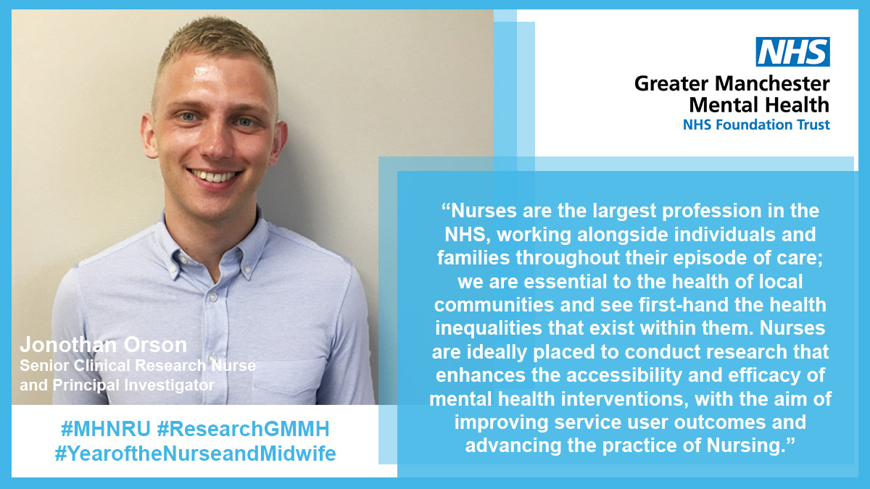
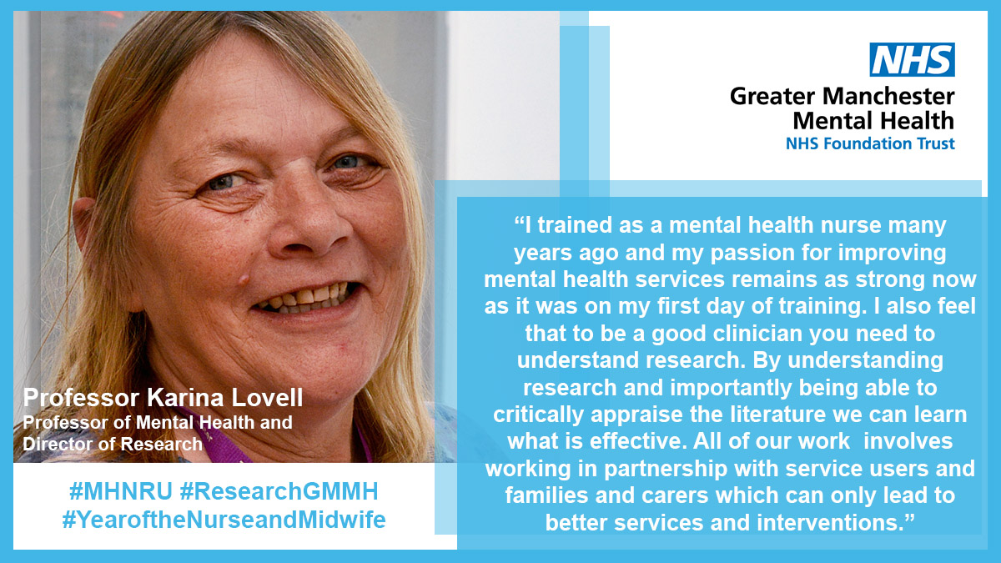
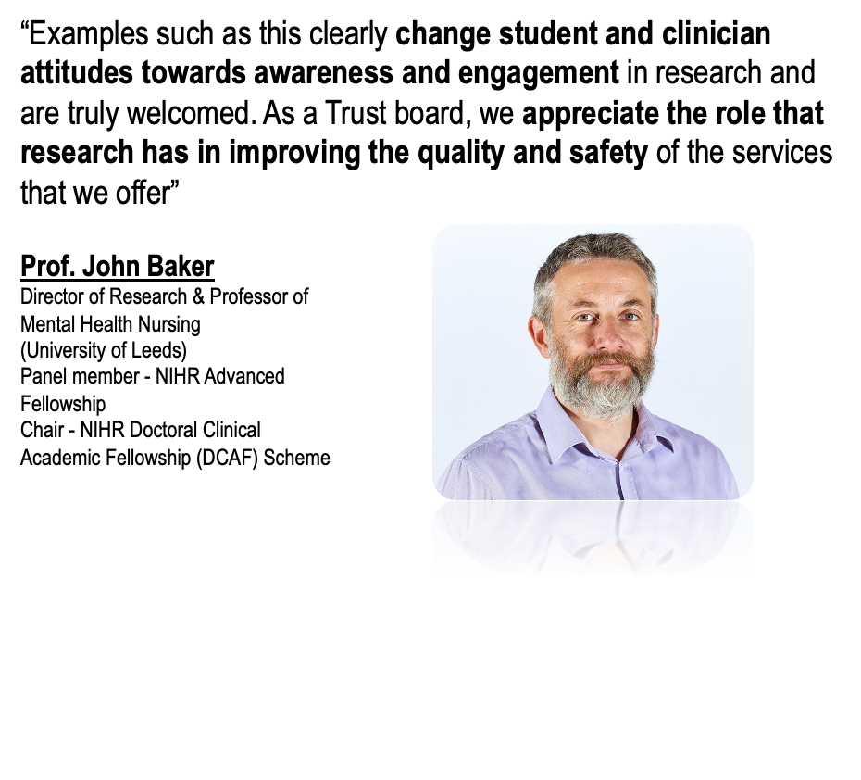
Benefits of Research Involvement
Notes:
Han

Slide 28
Contact Us
Learn about a research study of interest hands on whilst in clinical placement
If you can help us develop this programme; want to become involved yourself; have interested students/staff; or merely want to know more; please get in touch.
Email: Wendy.andrusjak3@nhs.net
Phone: 07980958438
Notes:
Wendy

